Slide 1
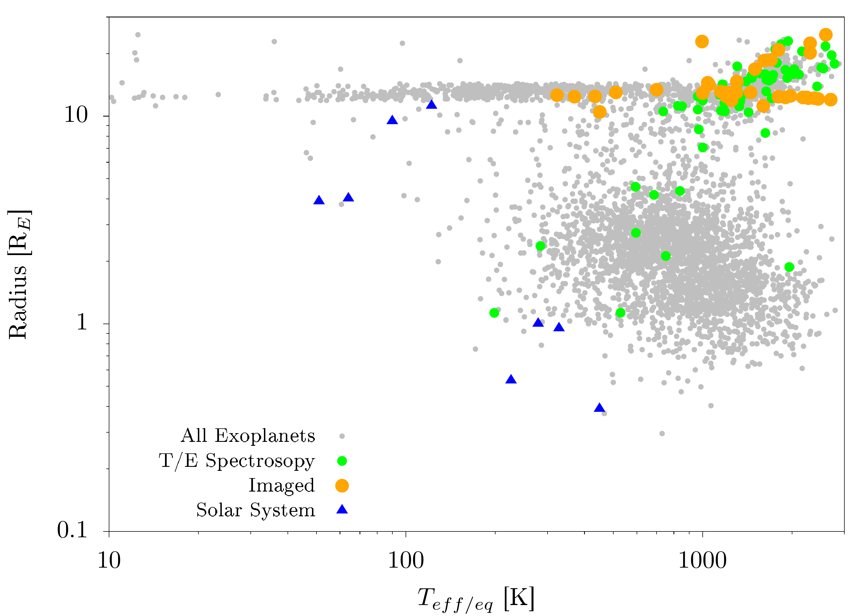
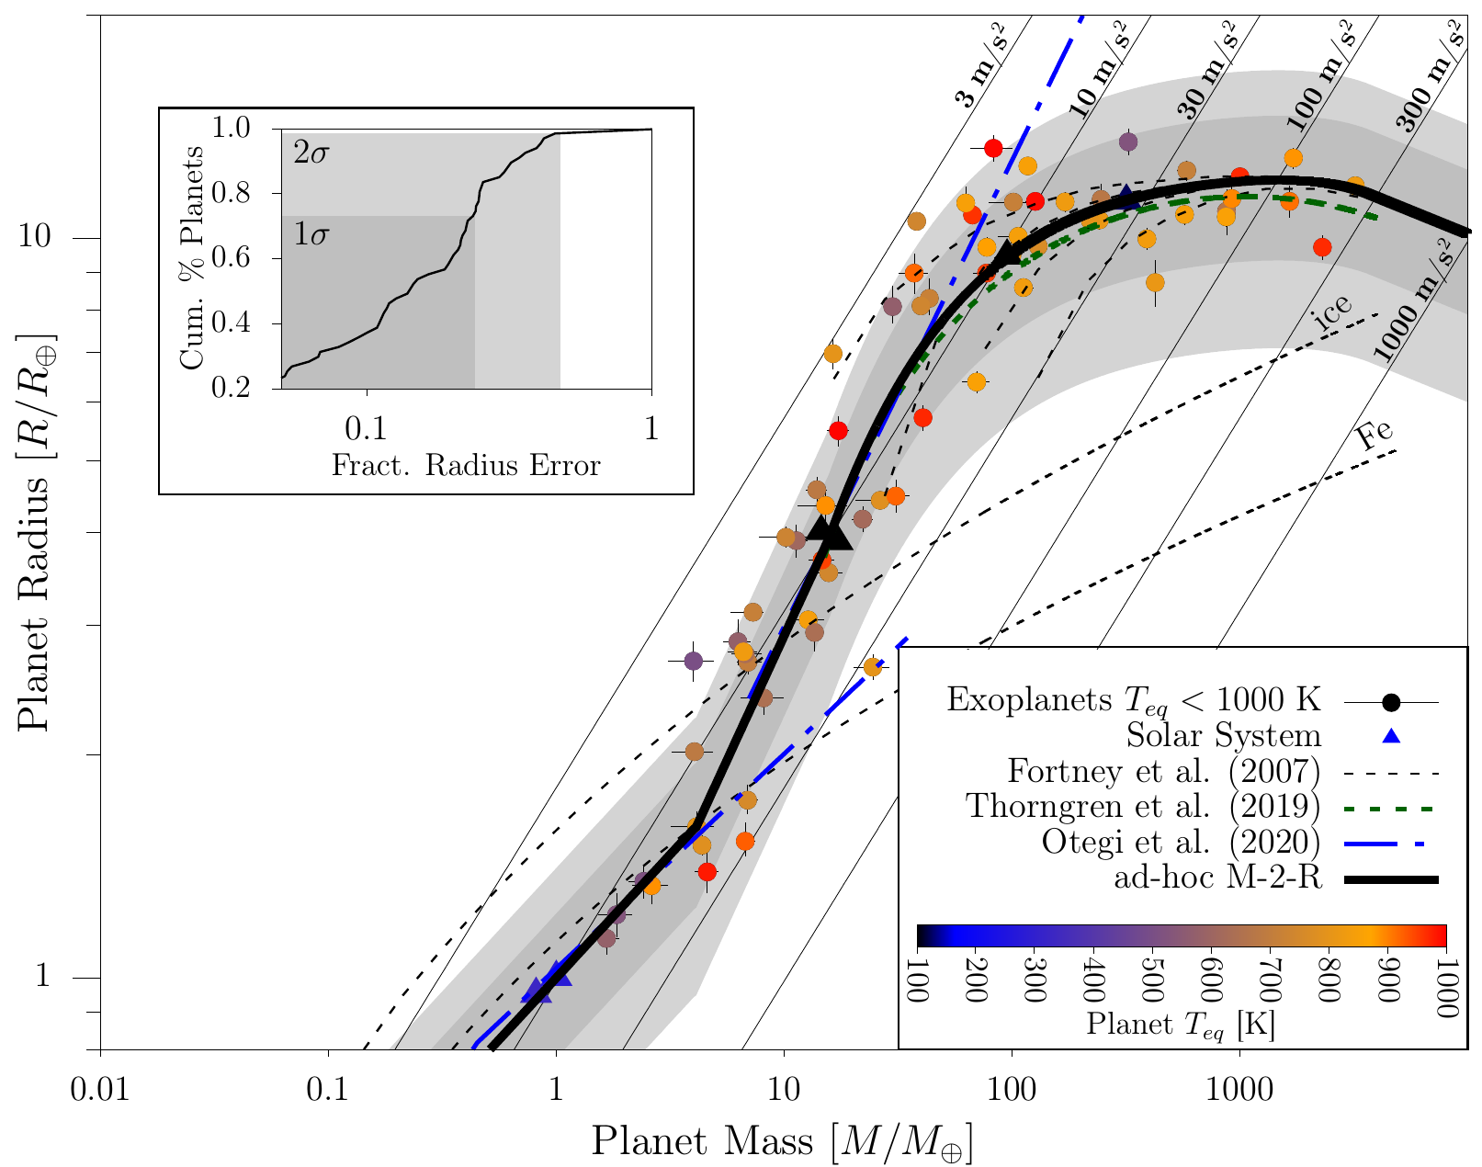
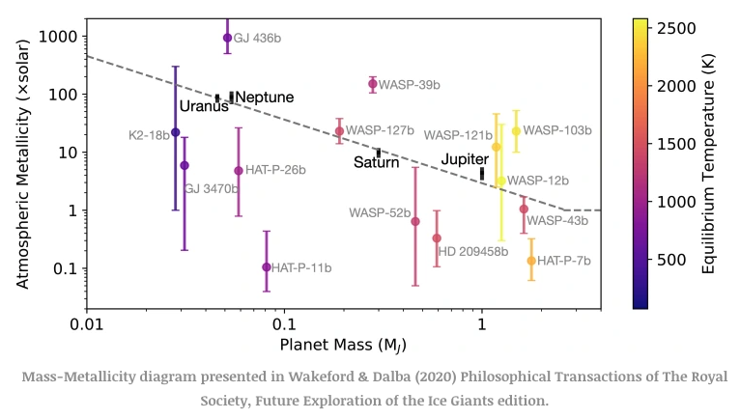
Select a Star
M5 MS
K2-K3 MS
K2-K3 RGB
F1 MS
F1 RGB
Teff = 3000
Rstar = 0.2Rsun
Mstar = 0.15Msun
FeH = 1
Log(g) = 5
Teff = 5000
Rstar = 0.8Rsun
Mstar = 0.8Msun
FeH = 1
Log(g) = 4.5
Teff = 5000
Rstar = 10Rsun
Mstar = 0.8Msun
FeH = 1
Log(g) = 2.3
Teff = 7000
Rstar = 1.7Rsun
Mstar = 1.5Msun
FeH = 1
Log(g) = 4.0
Teff = 7000
Rstar = 10Rsun
Mstar = 1.5Msun
FeH = 1
Log(g) = 2.6
Select a Planet
Typical masses/radii for given Teff from Mamajek table:
https://www.pas.rochester.edu/~emamajek/EEM_dwarf_UBVIJHK_colors_Teff.txt
Neptune-Saturn Intermediate
Neptune
Saturn
Jupiter
Super Jupiter
Radius = 4 Rearth = 0.35Rjup
Mass = 17Mearth = 0.05Mjup
Metallicity = 100
Radius = 6 Rearth = 0.54Rjup
Mass = 30Mearth = 0.09Mjup
Metallicity = 50
Radius = 9 Rearth = 0.8Rjup
Mass = 95Mearth = 0.3Mjup
Metallicity = 10
Radius = 11Rearth = 1Rjup
Mass = 317Mearth = 1Mjup
Metallicity = 3
Radius = 10 Rearth = 0.9Rjup
Mass = 1560Mearth = 5Mjup
Metallicity = 1
Select a Separation -> Eq Temp
0.1 au
0.5 au
1 au
3 au
10 au
0.5
Select a C/O ratio
1.5
Select Phase
Variables kept constant:
140 deg
T_int = 100K
noTiVO = True
Rfacv = 0.5
Nstr_upper = 85
Nlevel = 91
Nstr_deep = 89
Nofczns = 1
P_bottom = 2
P_top = -6
120 deg
Base model
Cloud-free Spectrum
90 deg
45 deg
0 deg
250 permutations
1250 permutations

Slide 2
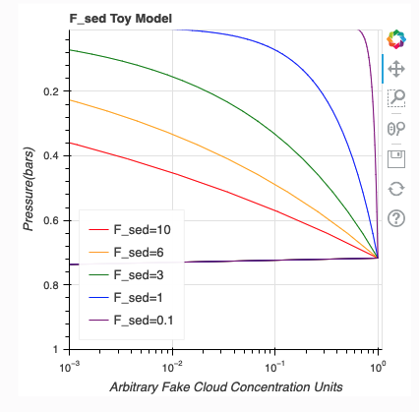
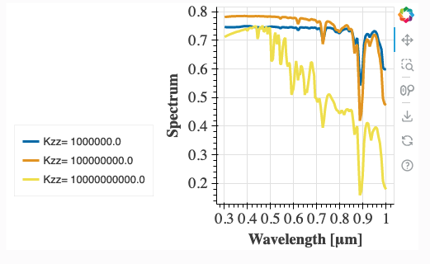
Base model
Select an f_sed
0.1
0.5
1
3
6
Select a K_zz
1e9
1e11
Cloudy Spectrum
Cloudy model
10 permutations per base model
Apply phase
12,500 total permutations

